Slide 1
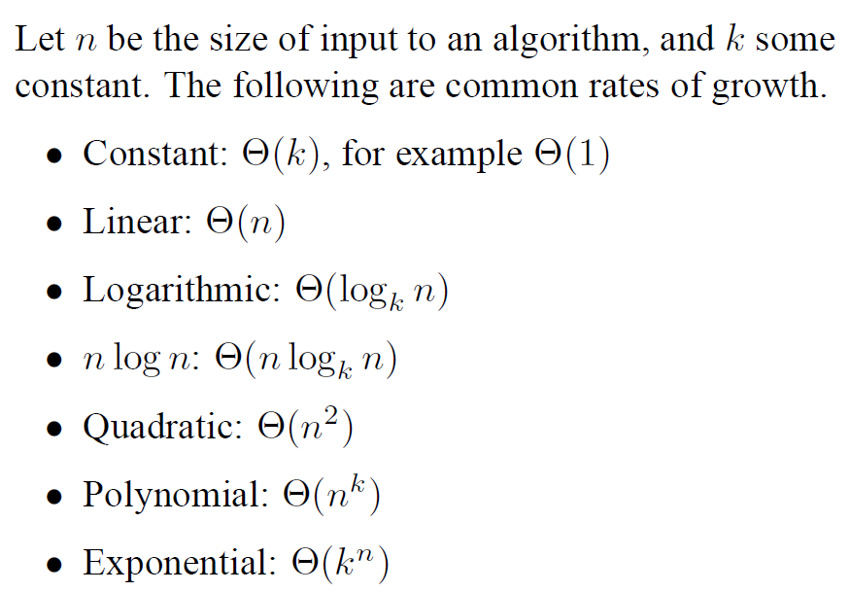
Complexity of Algorithms

Slide 2
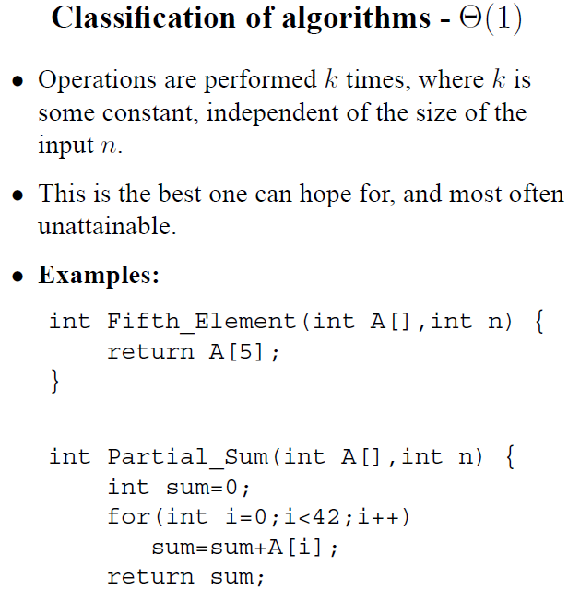

Slide 3
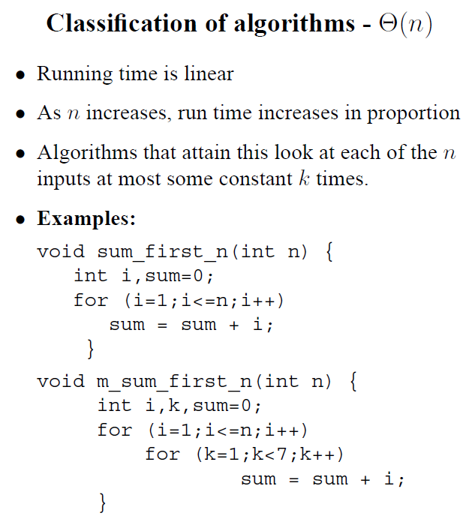

Slide 4
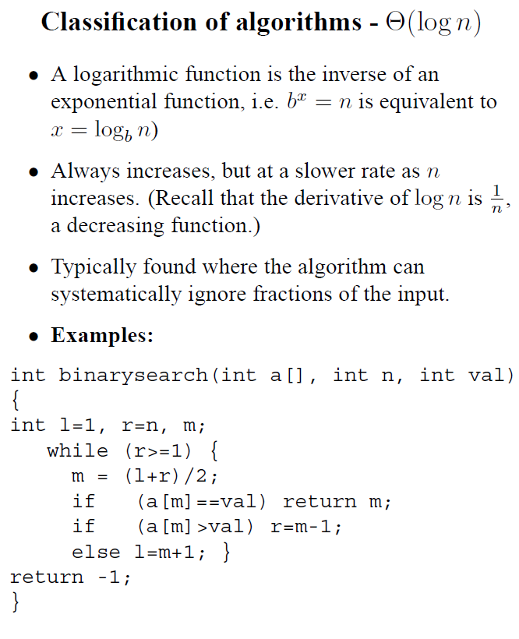

Slide 5
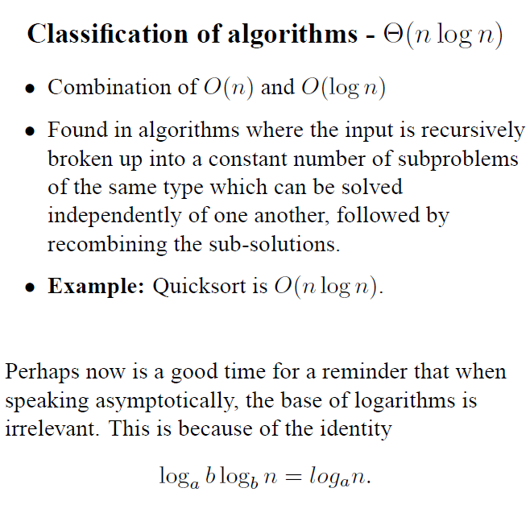

Slide 6
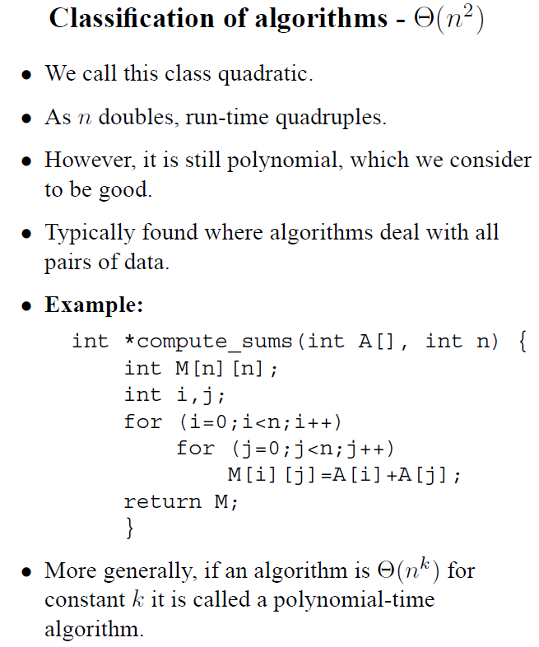

Slide 7
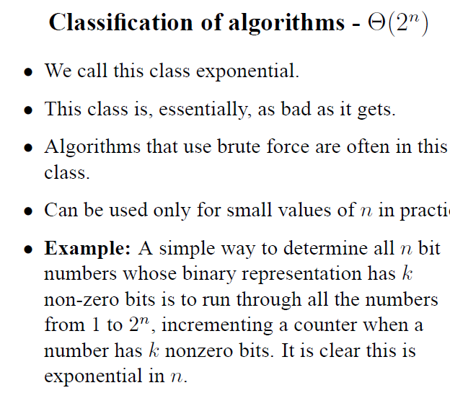

Slide 8

Math you need to Review
Summations
Logarithms and Exponents
Proof techniques
Basic probability
properties of logarithms:
  log_{b}(xy) = log_{b}x + log_{b}y
  log_{b} (x/y) = log_{b}x - log_{b}y
  log_{b}xa = alog_{b}x
  log_{b}a = log_{x}a/log_{x}b
properties of exponentials:
  a^{(b+c)} = a^{b}a ^{c}
  a^{bc} = (a^{b})^{c}
  a^{b} /a^{c} = a^{(b-c)}
  b = a ^{log}_{a}^{b}
  b^{c} = a ^{c*log}_{a}^{b}
Analysis of Algorithms

